Slide 1
1. A female bob cat has a trait which comes from a single gene; the bob cat gets a copy of that gene from __________.
her mother only
either her mother or her father, depending on the gene
her father only
both her mother and her father

Slide 2
2. Which of the following is an example of an inherited trait?
A. darkness of skin after sunbathing
B. attained muscle mass
C. a person's eye color
D. enjoyment of reading

Slide 3
3. For human skin color there is a gene which controls red tones and a gene which controls dark brown tones in each individual. Therefore you can deduce that for human skin color, __________.
multiple genes are used to determine this single trait
the gene for one color comes from one parent, and the gene for the other color comes from the other parent
the color of your skin is based upon you receiving the red gene or the brown gene
All of the above statements are correct.

Slide 4
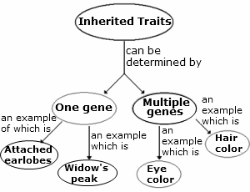
Which of the following would be the BEST title for the concept map above?
A. Correlation Between Genes and Inheritance Patterns
B. Genetic Differences in Features of the Face
C. Some Examples of Multiple Gene Traits
D. Examples of Traits Determined By One or More Alleles

Slide 5
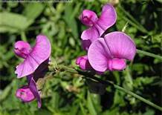
In pea plants, flower color is an inherited trait. Pea plants can have either purple or white flowers.
A student breeds one purple-flowered pea plant with a white-flowered pea plant and observes the flower color of the offspring plants. This investigation can BEST help the student answer which question?
A. What is the relationship between the soil type and the flower color of a pea plant?
B. What temperature is best for producing purple-flowered pea plants?
C. Is the flower color of a pea plant affected by the amount of water the plant receives?
D. How do pea plants' alleles for flower color interact?

