Slide 1
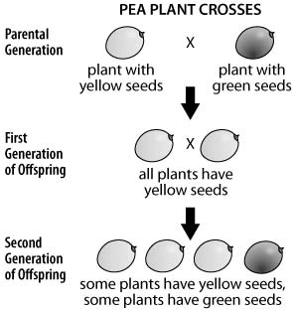
A scientist crossed pea plants with different seed colors. The diagram shows the results of the crosses.
Which statement best explains these results?
A The allele for yellow seeds is dominant over the allele for green seeds.
B The allele for yellow seeds is stronger than the allele for green seeds.
C The allele for yellow seeds mutated to form the allele for green seeds.
D The allele for yellow seeds is more common than the allele for green seeds.

Slide 2
An offspring inherits one allele for a trait from each parent. The allele from the mother is expressed in the offspring if the allele
A. evolved earlier in the history of the species.
B. is dominant over the allele inherited from the father.
C. is different from the allele inherited from the father.
D. provides adaptations that help the offspring survive.

Slide 3
A certain kind of pea plant has an allele for tall and an allele for short but its overall phenotype is tall. Based on this information it can be determined that __________.
A. all pea plants are tall
B. tall is the dominant allele for height in pea plants
C. short is the dominant allele for height in pea plants
D. this pea plant has a homozygous genotype for height

Slide 4
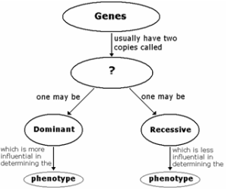
Which of the following BEST completes this concept map?
A.chromosomes
B. alleles
C. parents
D. DNA

Slide 5
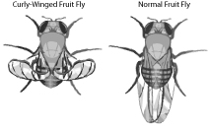
The pictures show a normal fruit fly and one with curly wings. The gene for curly wings is dominant in fruit flies. Which of the following will mean that a fruit fly will have curly wings?
A. The fly has one or more alleles for the curly-winged trait.
B. The fly has a single allele for wing shape in its somatic cells.
C. All of its genes code for the curly-winged trait.
D. All of its genes except for the curly-winged gene are recessive.

