Slide 1
Organ systems found in multicellular organisms are composed of differentiated cells. Differentiated cells are cells that are
unspecialized in function.
also known as stem cells.
specialized in their function.
not yet fixed in development.

Slide 2
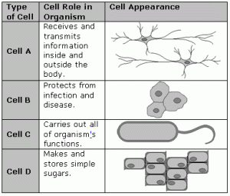
The table above gives information about four unknown cells types. The table above gives evidence that most cells have
A. different appearances, but the same functions.
B. different functions and different appearances.
C. the same appearance, but different functions.
D. the same appearance and the same function.

Slide 3
The tissues that make up the heart and the lungs are composed of very different types of cells. How do the differences between these cell types arise?
The birth process causes the cells to change.
The cells differentiate in the developing embryo.
The cells receive different genetic material during mitosis.
One cell of each type is passed on from parent to offspring.

Slide 4
When does cell differentiation typically occur in humans?
after fertilization, before formation of the zygote
after formation of the zygote, before the embryo forms
after formation of the embryo, before birth
after birth

Slide 5
As a multicellular organism grows and develops from a single cell, what happens to its cells?
they become specialized
they become bigger
they get stronger
they remain the same

